Slide 1




Pneumonia Detection
Group number : 12
Guide :Arashdeep Kaur
Dejoe Varghese John (dj 324)
Ayush Dewan (ad2293)
Salma Shaik (ss4942)
Kiran Mayee Bellam (kb634)

Slide 2

ABSTRACT
Pneumonia is an infection of the lungs affecting primarily the small air sacs known as alveoli. The Global Burden of Disease Study 2015 found lower respiratory infections(LRIs) were the leading infectious cause of death and the fifth leading cause of death overall. Pneumonia caused 55% of LRI deaths in all ages (1.5 million deaths).
Diagnosis is often based on symptoms and manual examination of chest X-ray which can be error prone.
This project aims to explore a new neural network architecture (ResNeXt50) and build a model to predict if an X-ray is NORMAL or has PNEUMONIA.

Slide 3

LITERATURE REVIEW
Article 1
2020
TITLE:Detection of Pneumonia clouds in Chest X-ray usingImage processing approach
Article 2
2022
Article 3
2021
Detection of Pediatric Pneumonia from X-Ray Images using ResNet50 and GAL Networks
Convolutional Neural Networks (CNNs) demonstrate high accuracy in detecting pneumonia from chest X-ray images.
Rigorous performance evaluation underscores the reliability of CNN models in distinguishing pneumonia cases from normal chest X-rays.
Pneumonia Detection in Chest X-ray Images using Convolutional Neural Networks
ResNet50 and GAL Networks effectively detect pediatric pneumonia from X-ray images.
The study underscores their potential as valuable tools for improving diagnostic accuracy in pediatric healthcare.
The study offers insights into improved pneumonia diagnosis methods, potentially benefiting medical imaging practices.
Pneumonia clouds in chest X-rays are effectively detected using an image processing approach.
Article 4
2019
Pneumonia Detection Using CNN based Feature Extraction
CNN-based feature extraction is effective in pneumonia detection from medical images.
Article 5
2016
Automated Pneumonia Detection from Chest X-Ray Images using Deep Convolutional Neural Networks
Deep Convolutional Neural Networks effectively automate pneumonia detection from chest X-ray images.
Article 6
2017
ChestX-ray8: Hospital-scale Chest X-ray Database and Benchmarks on Weakly-Supervised Classification and Localization of Common Thorax Diseases
This approach demonstrates promise for automating and improving diagnostic accuracy in pneumonia detection.
The developed system shows promise for enhancing diagnostic accuracy and efficiency in healthcare settings.
ChestX-ray8 offers a vast collection of chest X-ray images for research.
It enables benchmarking on weakly-supervised classification and localization of common thorax diseases, aiding in medical image analysis.

Slide 4
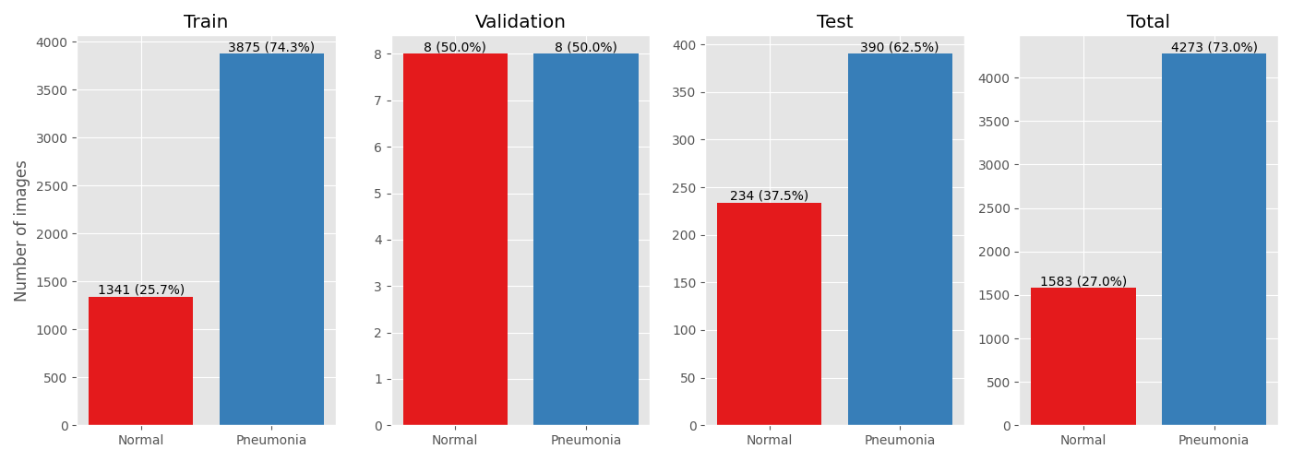
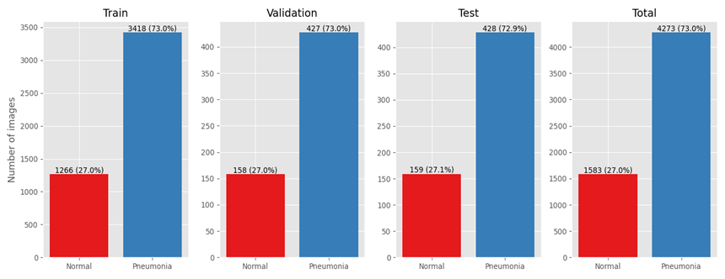
DATA GATHERING AND DATA PREPROCESSING
Dataset Overview:
Source: Chest X-Ray Images for Classification (Mendeley Data)
Total Images: 5863
Categories: Training (5216), Testing (624), Validation (16)
Issues with Original Split:
Validation set inadequately small (only 16 images)
Potential bias in model evaluation
Solution Implemented:
Utility method to resample and resplit
New split: 80-10-10 ratio
Preserved overall class balance
New Dataset Distribution:
Training: 4690 images
Testing: 586 images
Validation: 587 images
Class distribution of the original dataset
Class distribution of dataset after resampling and resplitting

Slide 5
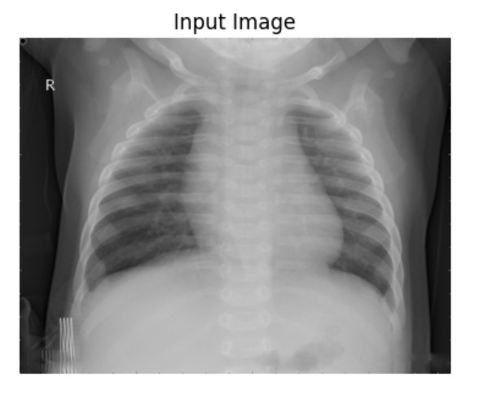
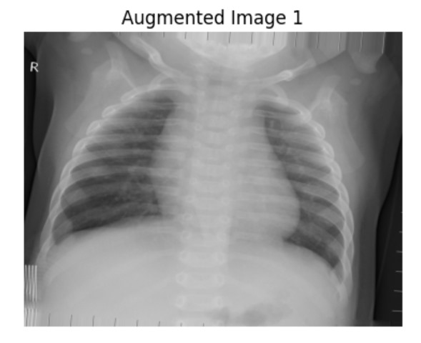
Data Augmentation
Used Image Data Generator from Keras for creating diverse and robust dataset by performing the following:
rescale=1./255: scales the pixel values of the image to the range [0, 1].
rotation_range=5: rotates the images within the range of -5 to +5 degrees.
width_shift_range=0.05: shifts the images horizontally by a maximum of 5% of the total width.
height_shift_range=0.05: shifts the images vertically by a maximum of 5% of the total height.
zoom_range=0.05: zooms into the images by a maximum of 5%.
brightness_range=[0.95, 1.05]: adjusts the brightness of the images within the specified range.
fill_mode='nearest': method used for filling in newly created pixels due to rotation or width/height shifts.

Slide 6
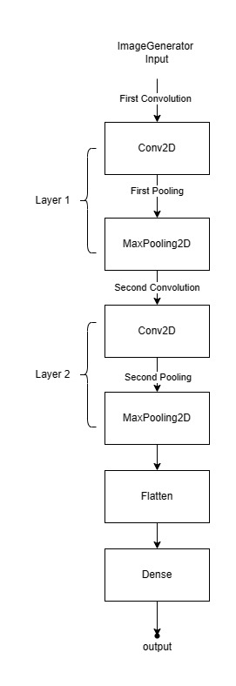
CNN - convolutional neural network
CNN is a sequential model which is applied to analyze images.
It consists of multiple layers –
Convolutional Layers:
Apply filters (kernels) to input data.
Extract features through convolutions.
Pooling Layers:
Reduce spatial dimensions of feature maps.
Downsample feature maps to decrease computation.
Fully Connected Layers:
Neurons connected to all activations in the previous layer.
Aggregate features for classification.
Output Layer:
Final layer for prediction.
Utilizes appropriate activation function based on task(e.g., softmax for classification).

Slide 7
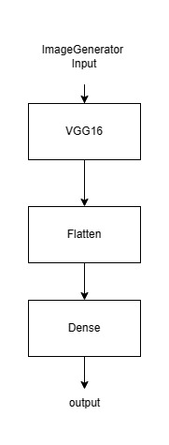
VGG 16
VGG16 is a Convolutional Neural Network architecture commonly used for image classification.
It is often trained on large datasets like ImageNet that can be used as a feature extractor.
VGG-16 consists of 16 layers, including 13 convolutional layers and 3 fully connected layers.
With 16 weight layers, VGG-16’s depth helps it recognize complex patterns in the input images.
It requires more computational Power and memory.

Slide 8
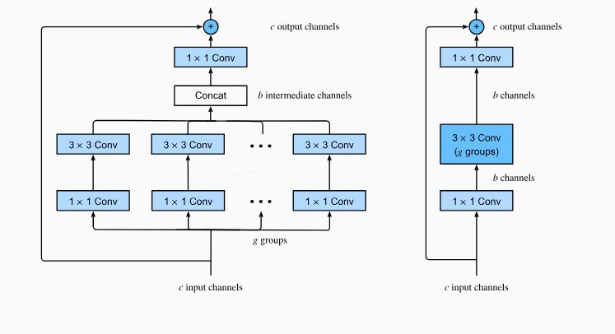
ResNeXt50 Architecture
ResNeXt50 Architecture:
Begins with two standard convolution layers and max-pooling
Multiple blocks of grouped convolution layers interleaved with max-pooling
Each block increases filter number and reduces spatial dimensions
Concludes with fully connected layers for classification
Utilizes ReLU activation functions throughout
Overfitting: The model cannot generalize and fits too closely to training dataset.
Overfitting Mitigation:
L2 Regularization: Adds penalty to loss function, encourages smaller weights
Dropout: Randomly disables neurons during training to prevent overfitting

Slide 9
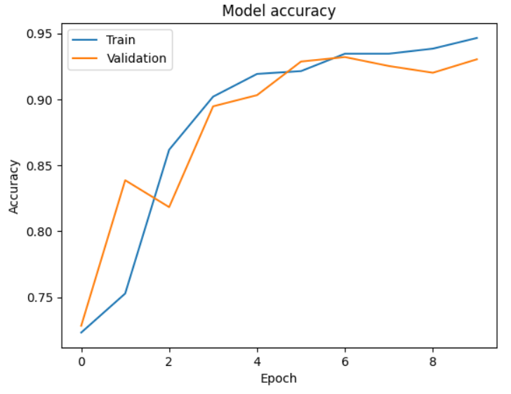
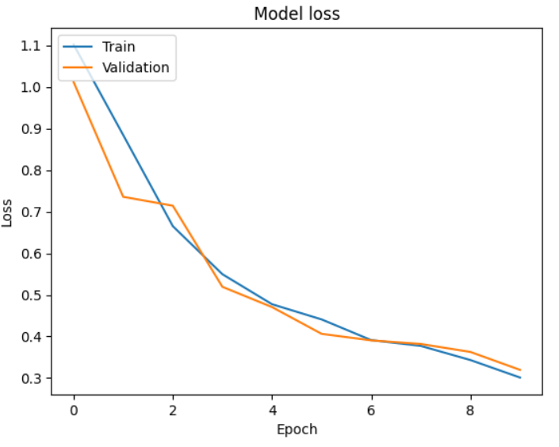
Model Evaluation Metrics
Training Accuracy:
Proportion of training samples correctly classified
Increasing training accuracy indicates improved performance on training data
Training Loss:
Average error between model predictions and actual labels on training data
Decreasing training loss signifies improved predictions over epochs
Validation Accuracy:
Proportion of validation samples correctly classified
Increasing validation accuracy indicates good performance on unseen data
Validation Loss:
Average error between model predictions and actual labels on validation dataset
Decreasing validation loss demonstrates correct generalization on new data
Model Accuracy over Epochs graph
Model Loss over Epochs graph

Slide 10
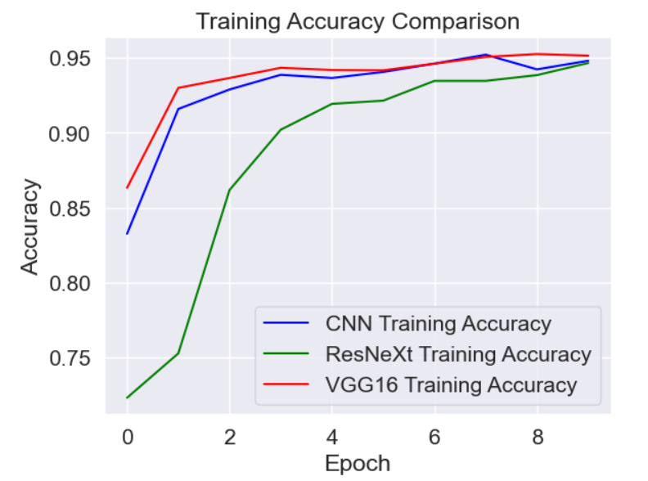
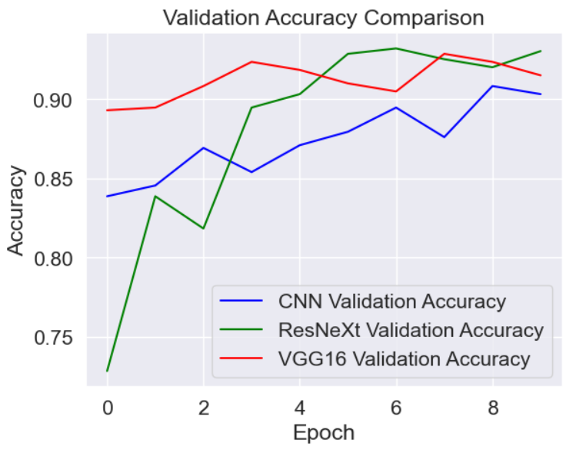
Comparing all three models
Model Type | Training Accuracy | Validation Accuracy
ResNeXt | 94.66% | 93.04%
CNN | 94.81% | 90.32%
VGG16 | 95.15% | 91.51%

Slide 11
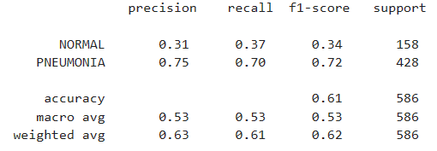
Classification Report
Precision: Measures the accuracy of positive predictions.
NORMAL class = 0.31 which means of all samples predicted as NORMAL, only 31% are correct.
PNEUMONIA class = 0.75 which means of all samples predicted as PNEUMONIA, only 75% are correct.
Recall: Measures the proportion of actual positives that were corrected identified.
NORMAL class = 0.37 which means 37% of all the actual NORMAL samples were correctly identified
PNEUMONIA class = 0.70 which means 70% of all the actual PNEUMONIA samples were correctly classified.
F1-score: Mean of precision and recall.
NORMAL class = 0.34
PNEUMONIA class = 0.72
Classification Report of ResNeXt50 model

Slide 12
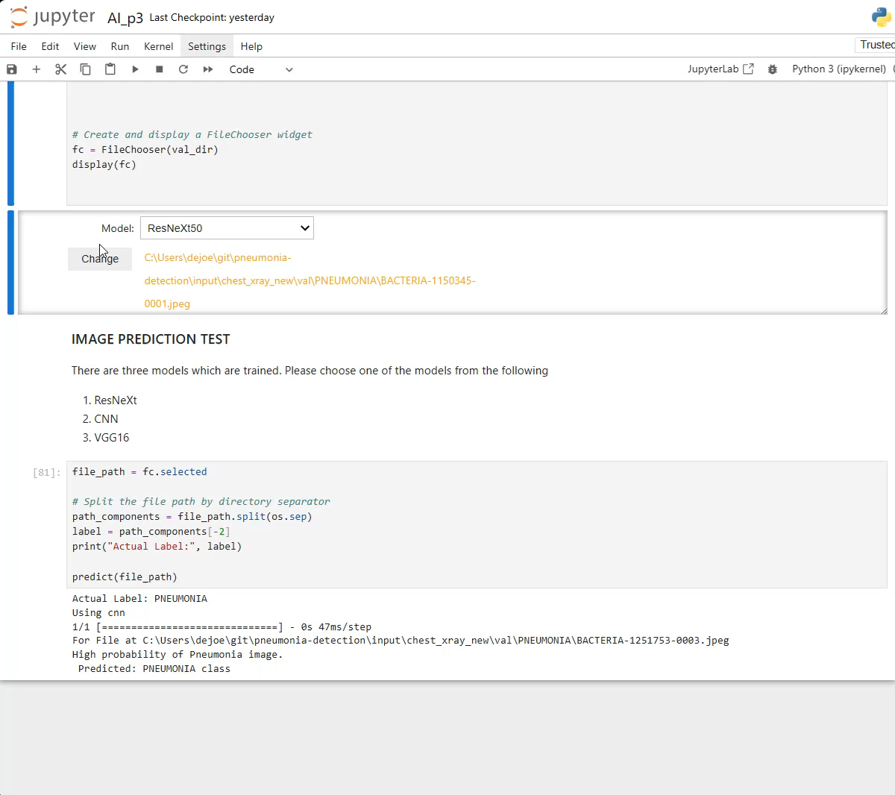
Demo

Slide 13
Conclusion
The model is better at identifying PNEUMONIA cases compared to NORMAL cases which is shown by higher precision, recall and F1-score for the PNEUMONIA class.
Future work –
would include investigation into misclassified samples which will provide insights into the model’s weaknesses and potential areas of improvement.
Use pretrained ResNeXt for transfer learning.
Fine Tuning the hyperparameters for improving the accuracy.
Check the model performance on the large dataset(100k images).

Slide 14
Thank You

